Slide 1

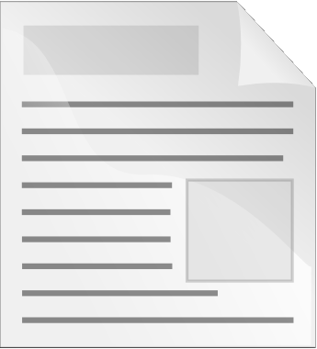
School of Information
Technology
Document Collaboration
http://www.istockphoto.com/stock-photo-5662949-global-network-xxxl-13333x8975-px-.php

Slide 2
Objectives
To provide you with an overview of
ways to collaborate on documents

Slide 3
Types of Document Collaboration
Authors work on separate documents
that are to be combined
Off-line tracked changes / version
control
Check in / out
Simultaneous on-line editing

Slide 4
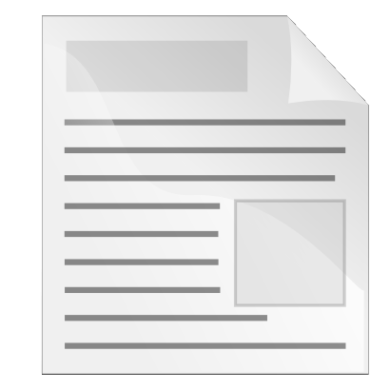

Simple Break-down into
Tasks / Sections
Each team member writes a separate section
Someone is responsible for assembling all the parts together
  Sharing a style template can make combining them easier

Slide 5
Manual Revisions
Editing and review
  Review and make changes
  Requires discipline

Slide 6
Manual Revisions
Editing and review (continued)
  Track changes
  Accept or reject changes made by others
  For example: Word, LibreOffice / OpenOffice.org, copies sent via email

Slide 7
Version Control
Manually: save with different names
You should always keep backups!
Many word processors allow a history to be stored
Keeps track of versions, and where milestones are reached
Revision control software can also be used to manage versions of any file (although this is slightly more complex)

Slide 8
Simple Version Control
May be saved within the document

Slide 9
Merging Similar Documents
Compare and merge
Can be complex if two people have changed the same sections of the document
Alice's Version
Bob's Version
Merged Document

Slide 10
Document Repository or
Document Management System
Client-server schemes allow users to check
documents in / out
Checked out documents may not be able to
be edited until it is checked back in
Schemes that allow multiple users to make
changes at the same time need to merge
changes and deal with conflicts
For example, when two users make local changes to the same part of the document then upload these to the server, how can this be handled?

Slide 11
Checking in and out
Master
Implemented by a client-server software solution, or a (very) diligent person in charge of maintaining the documents

Slide 12
Simultaneous Online Editing
Often cloud-based:
Web application (accessed via web browser)
Documents may be stored in the cloud
Minimum software requirements on the client side

Slide 13

Real-time Simultaneous Editing
Rather than sending out copies of the document to be merged later, a URL is sent to the other authors and they make changes to the one copy of the document
There is only one copy

Slide 14
Real-time Simultaneous Editing
Examples
  Google docs (word processor, spreadsheets...)
  Zoho (similar to Google Docs)
  ThinkFree (enables offline editing)
  Etherpad (plain text only)

Slide 15
Wiki
Web interface for managing content, and
allowing multiple users to make changes
Website that can be private or public
Examples:
  MediaWiki (used by Wikipedia)
  TWiki
  Google Sites

Slide 16
Simultaneous Editing
Either:
  Users can see the changes that others are making in real-time
Or:
  Users can make changes until they choose to share them

Slide 17
Disadvantages of “the Cloud”
Disadvantages of storing documents “in the
cloud”
Your files are stored on servers controlled by someone else
  Who owns the documents?
  (read the terms of service)
  Security is dependent on them
Make sure you still have your own backups

Slide 18
Summary
There are lots of ways to collaborate on documents, web sites, and information
Choose a method your whole team will be able to access
Choose a method of collaboration early on, and make sure that everyone knows how you will work as a team

